Slide 1


ADVANCED INTEGRATED RESPONSE & AID ASSISTANT
Rapid response for any emergency, anywhere

Slide 2
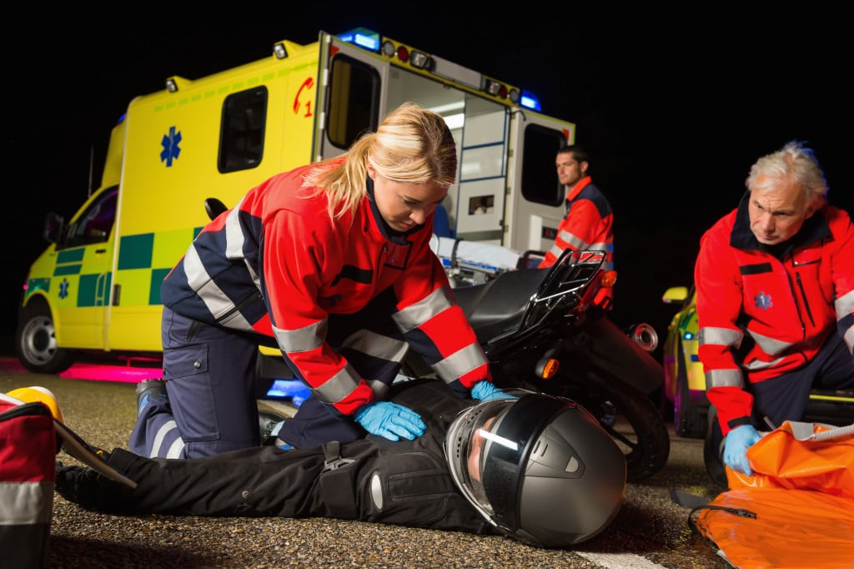
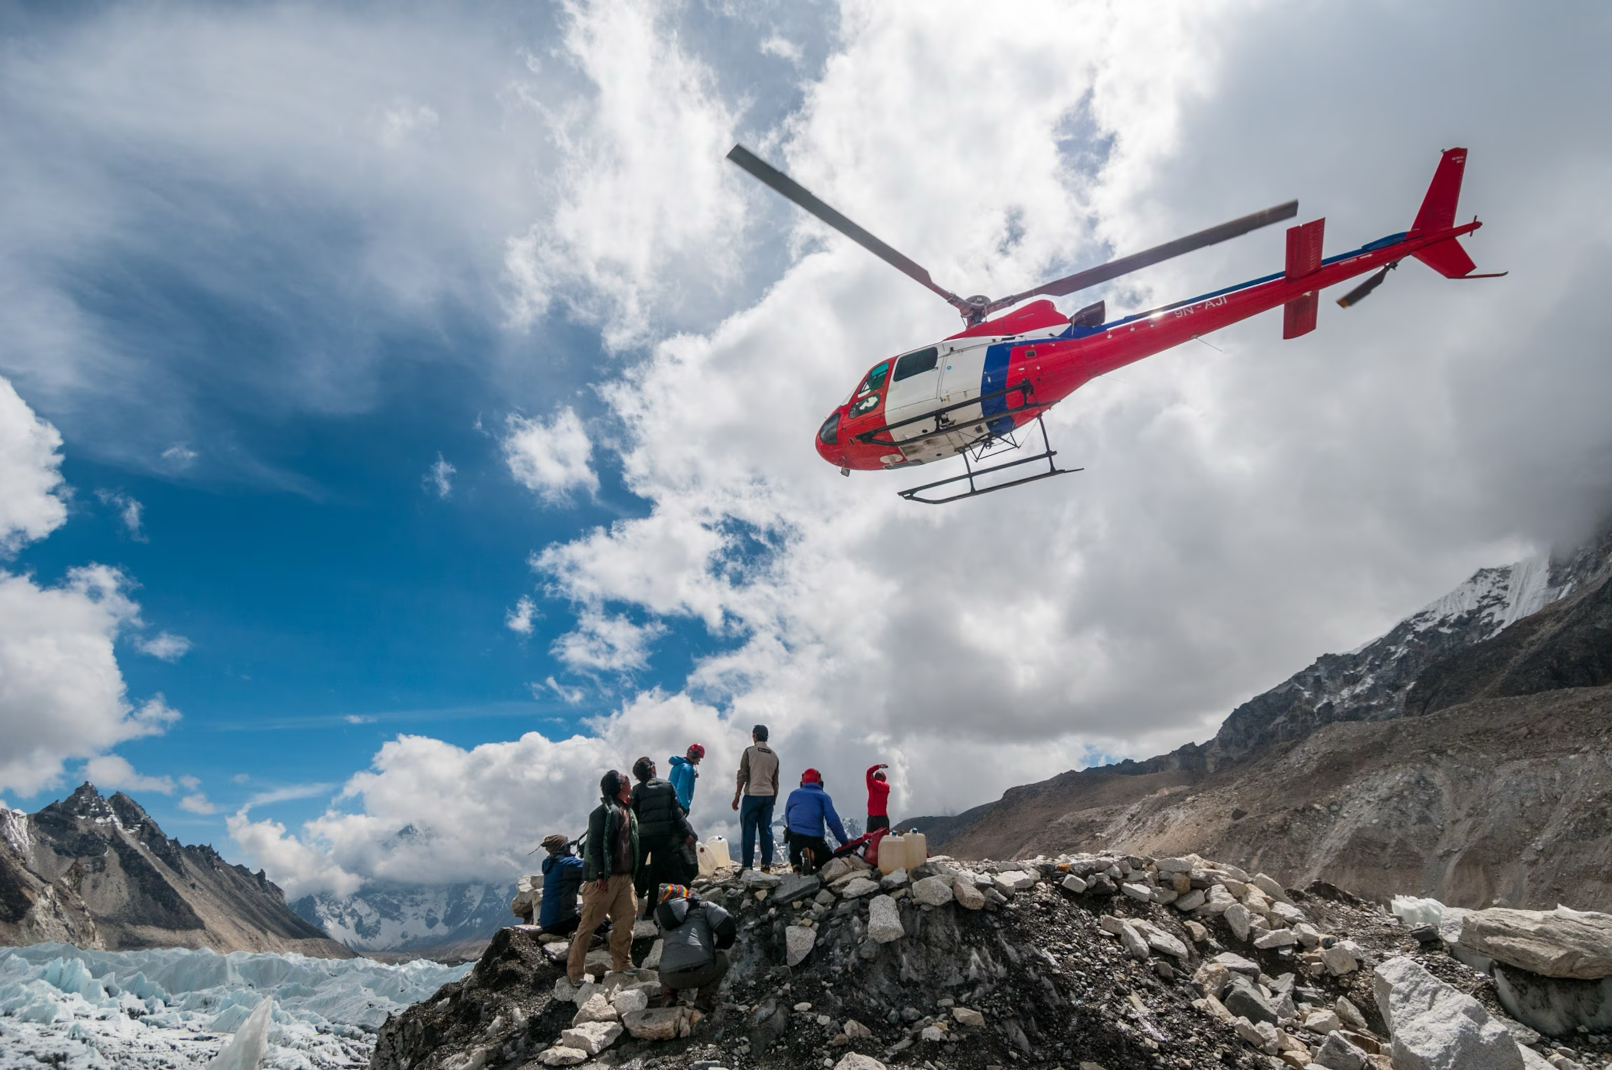
Goal: Reduce Response Time of Rescues and First Aid
SAVE MORE LIVES

Slide 3
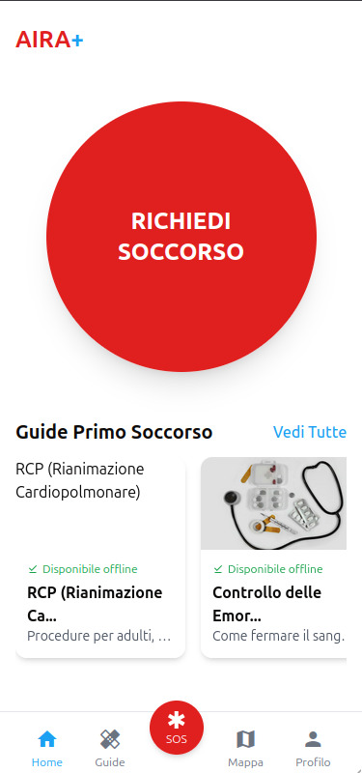
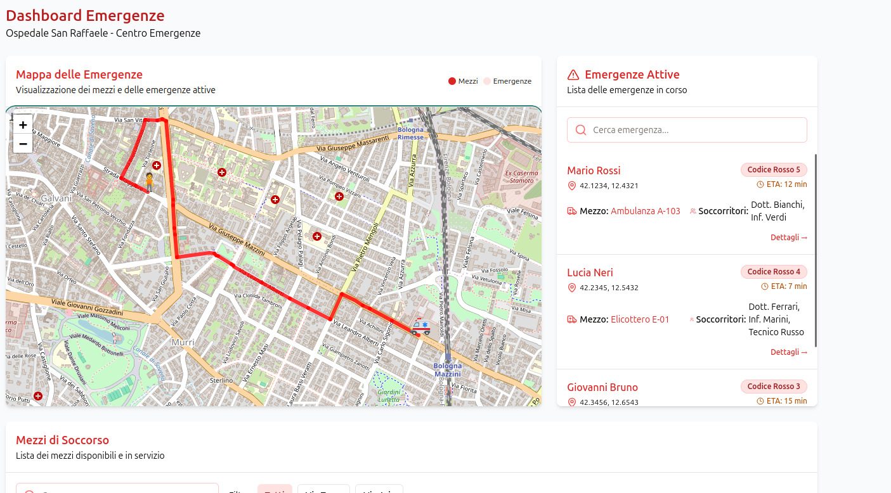
Our 2-in-1 Solution
MOBILE APP
ADMIN PANEL

Slide 4
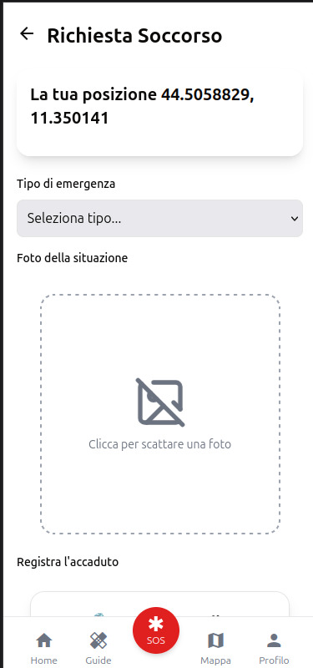
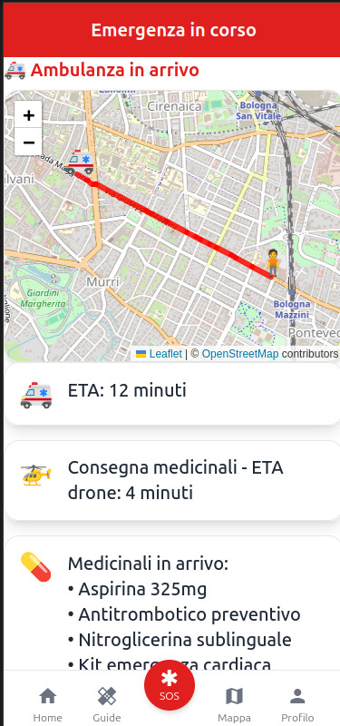
Mobile App: Ask For Help

Slide 5
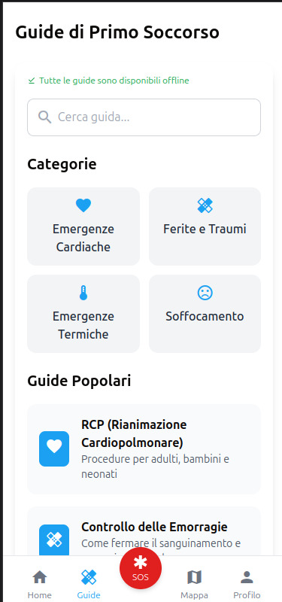
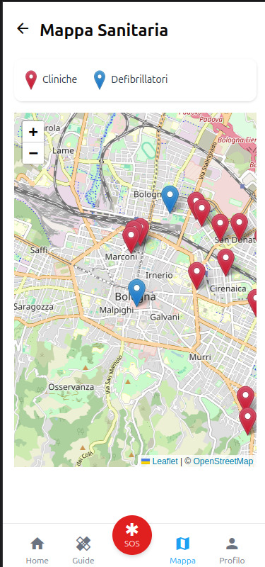
Mobile App: Search For Help Nearby

Slide 6







7 Ways to Handle Emergencies
VOICE
TEXT
SATELLITE CONNECTION
112 NUMBER
LIVE MEDICAL SUPPORT
PERSONAL CONTACTS
IN-APP GUIDES

Slide 7
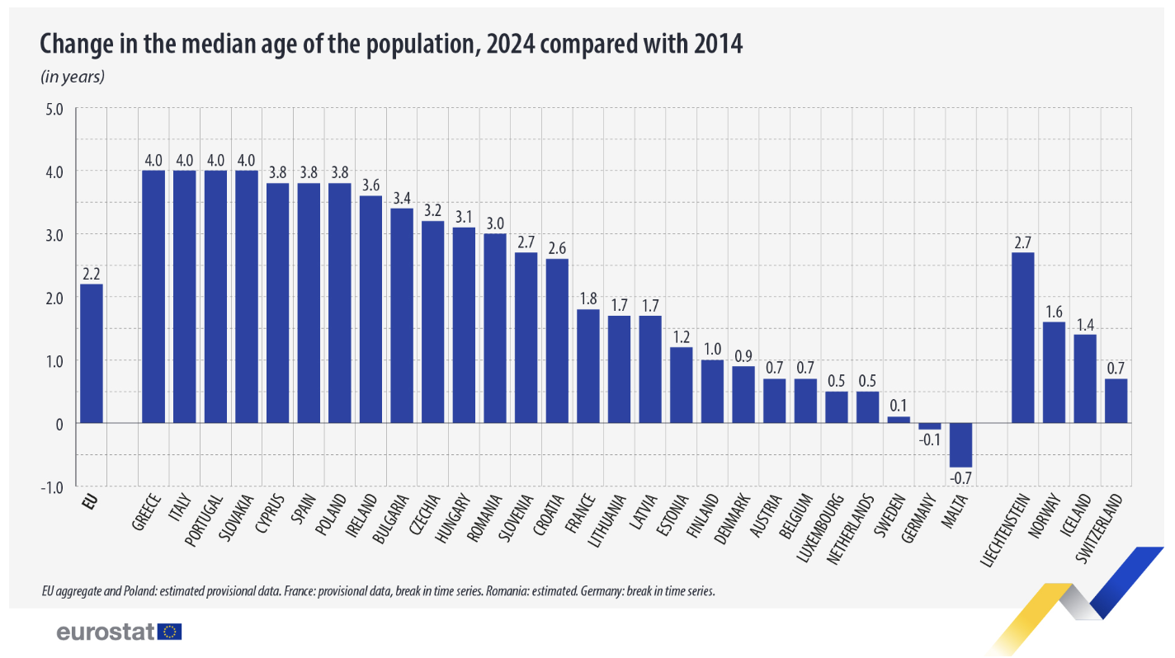
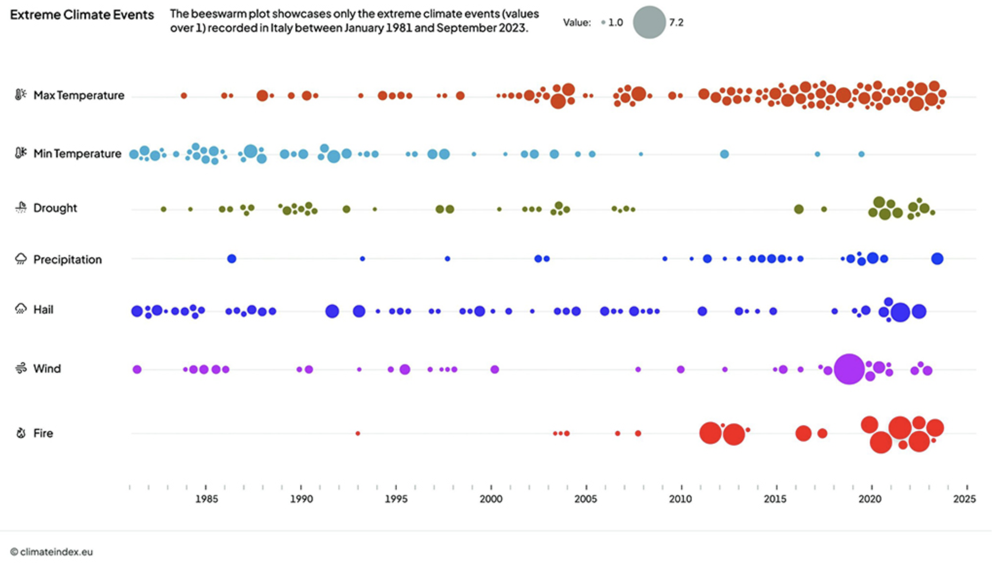
Market Analysis: Current Data and Projections
AGING POPULATION | +2.2 YEARS 2014-2024
CLIMATE EVENTS NUMBER GROWTH | ITALY 1981-2023

Slide 8
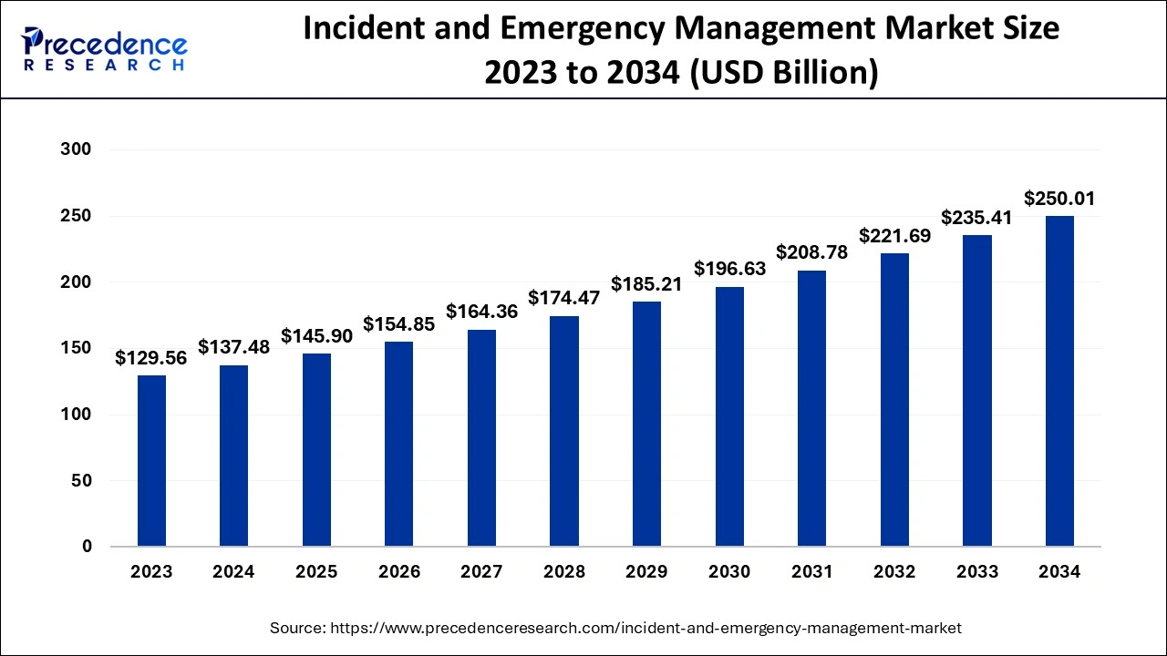
Emergency Market Size: Opportunity
200+ Billion $ Market by 2034
+85% Growth in 10 Years

Slide 9
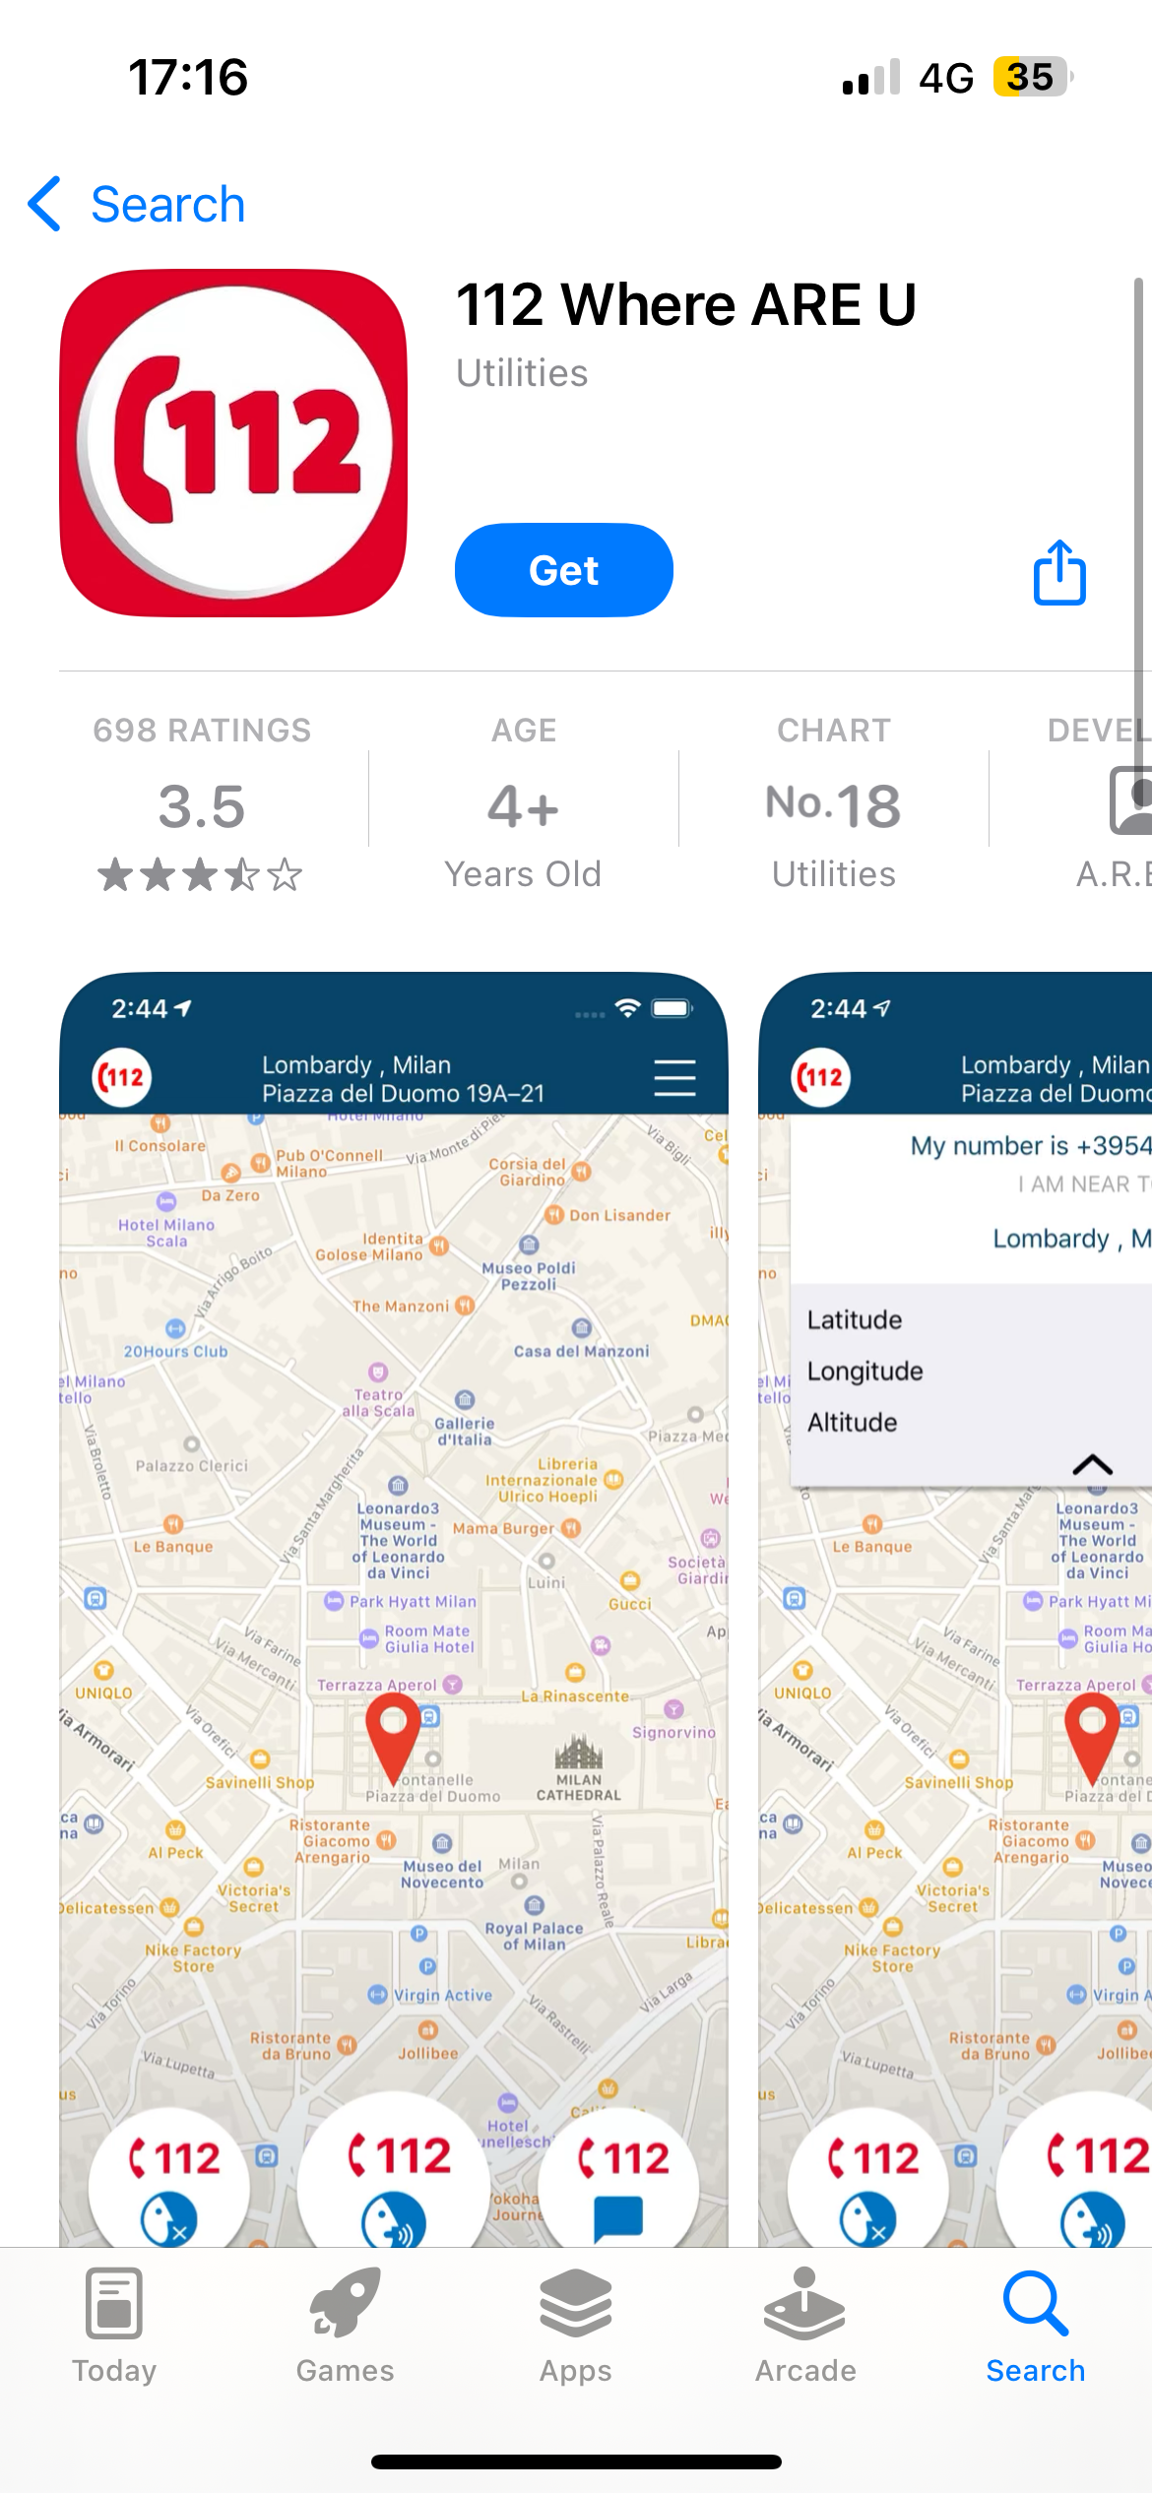
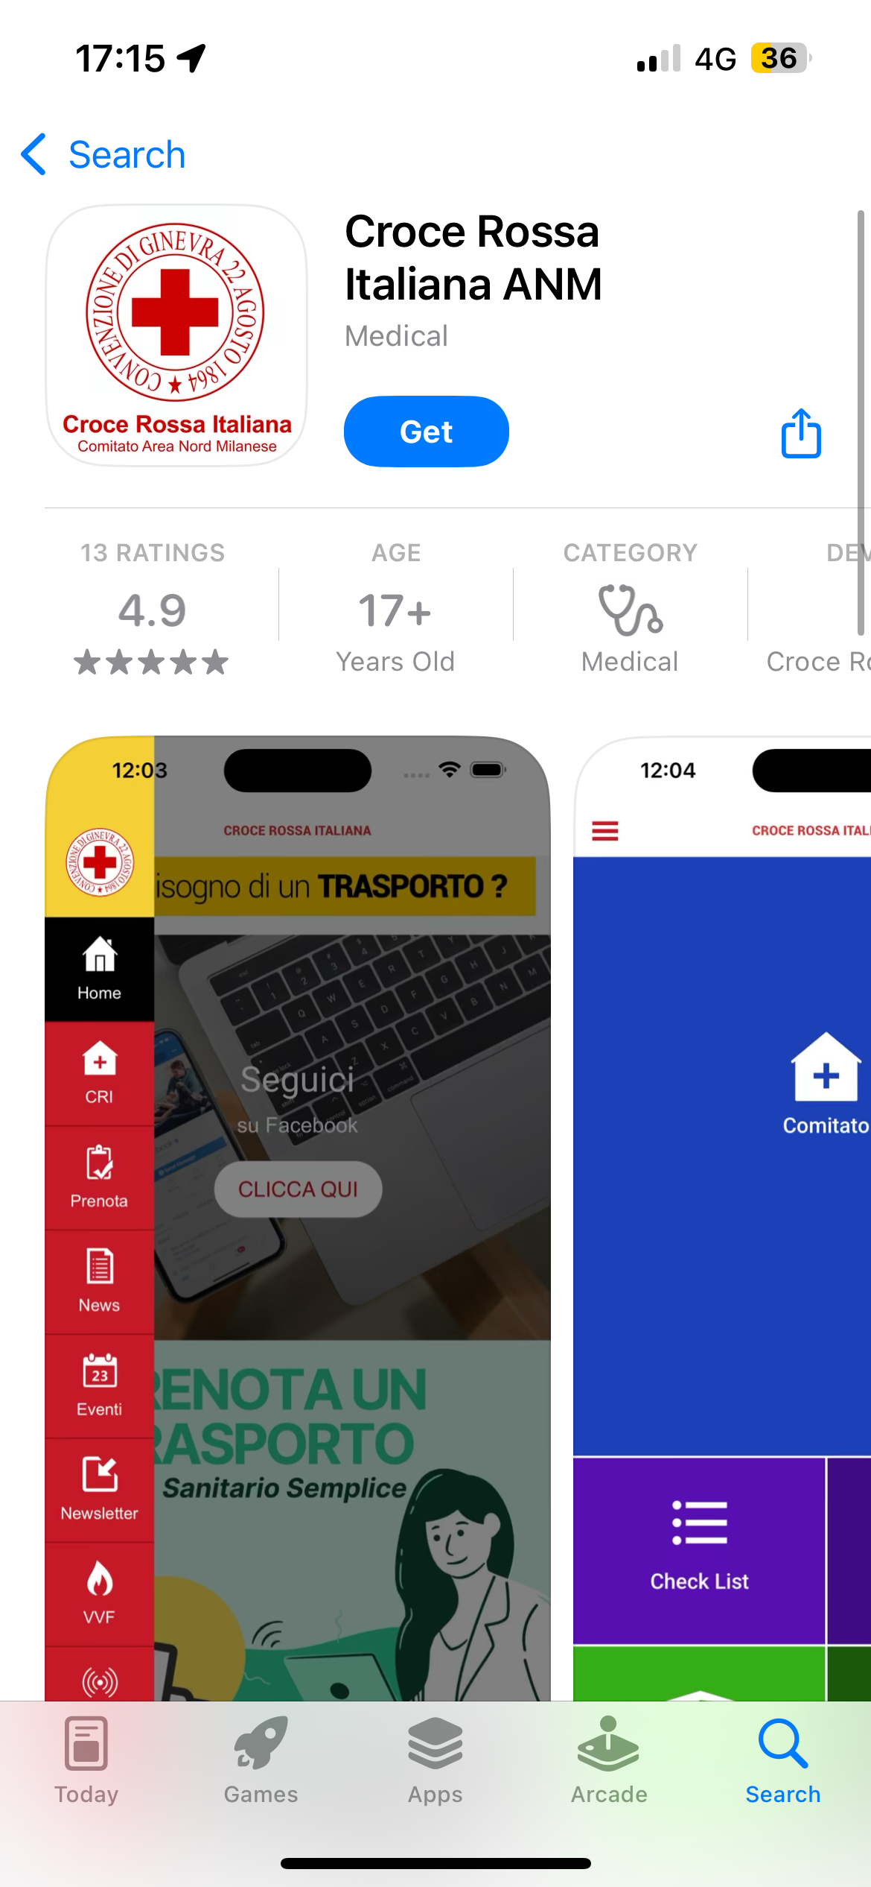
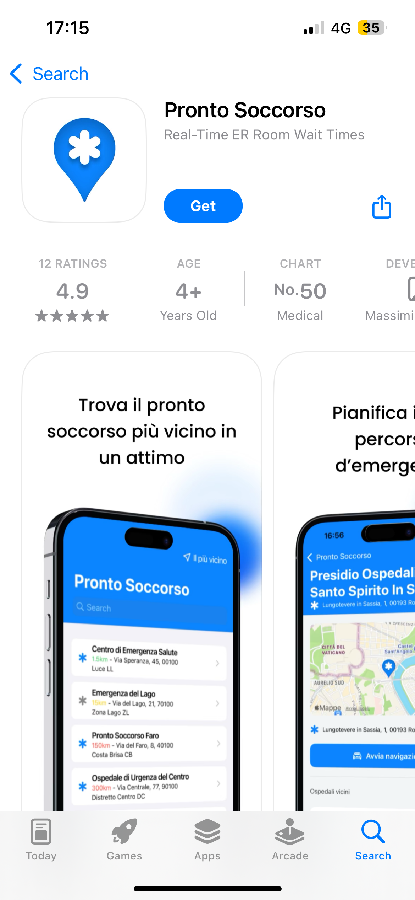
Existing Localization and Information Apps
MARKET SHARE OPPORTUNITY

Slide 10

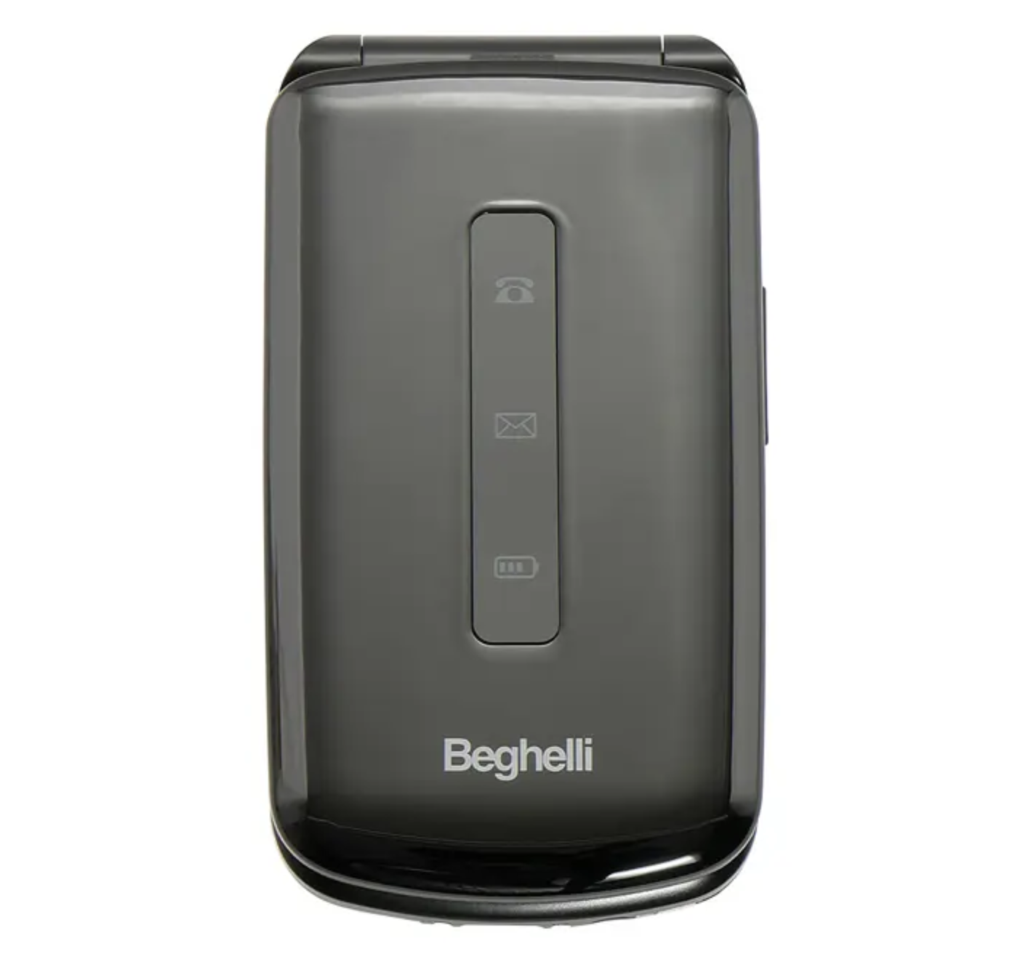
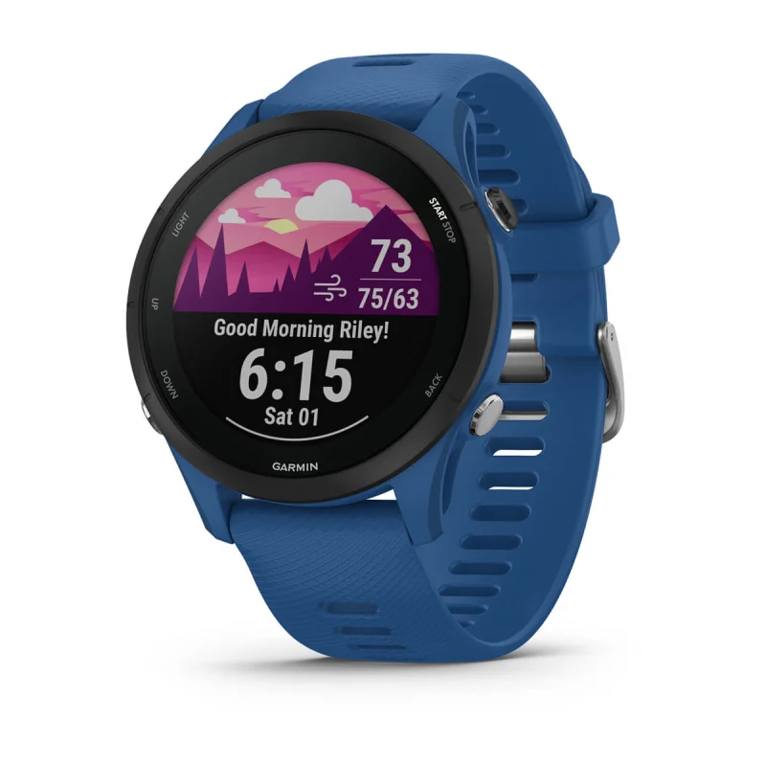
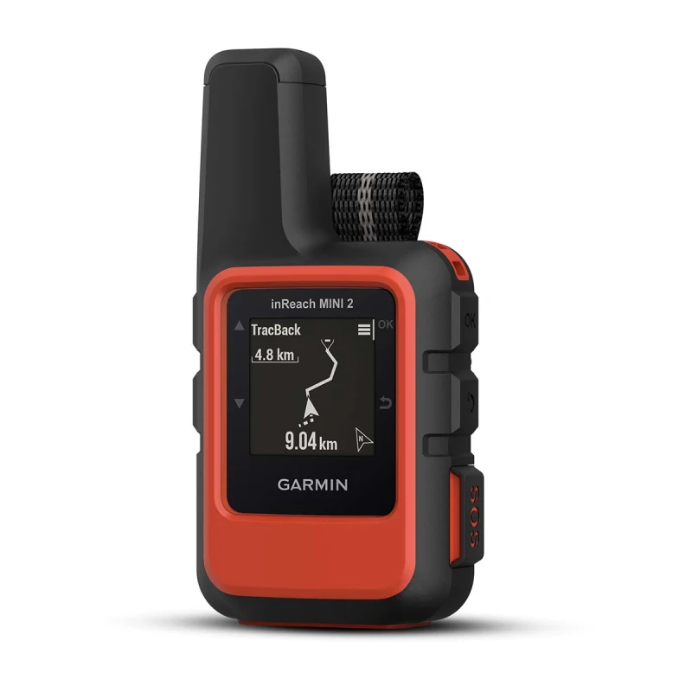
Existing Emergency and Satellite Services
BEGHELLI “SALVALAVITA” POCKET & PHONE
GARMIN FORERUNNER & INREACH
SYSTEM INTEGRATION OPPORTUNITIES

Slide 11






System Architecture

Slide 12
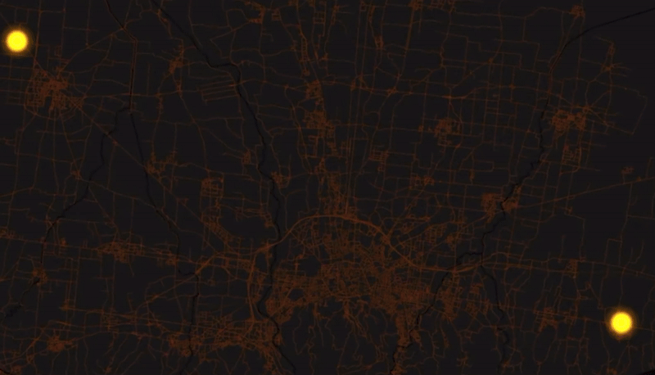

Data-Enhanced Path Finding Algorithm

Slide 13
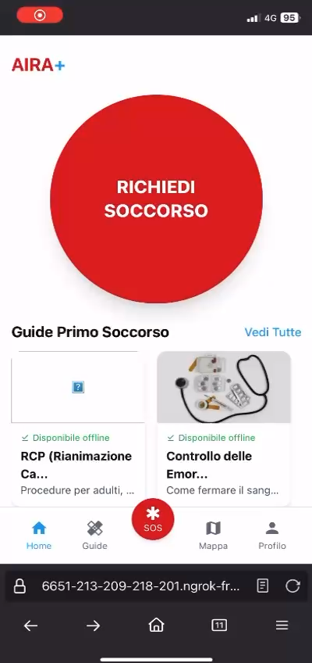
Video Demo of Our Solution

Slide 14



Financing: European Ongoing Space Initiatives
IMERA (LAUNCH: MID 2026)
IRIS SQUARE (LAUNCH: 2030)
POTENTIAL FOR
EUROPEAN FUNDING

Slide 15


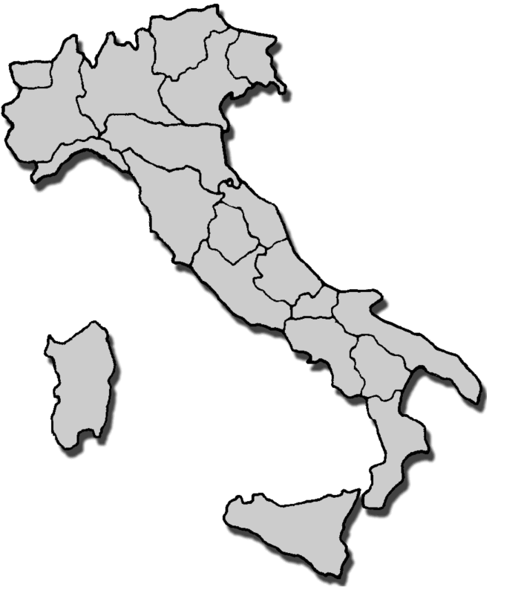


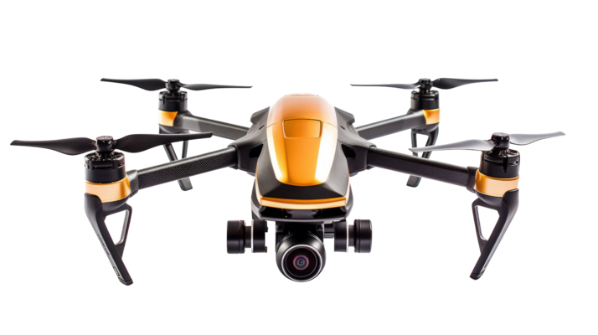


Roadmap 2025 - 2030
2030
2029
2028
2027
2026
2025

Slide 16


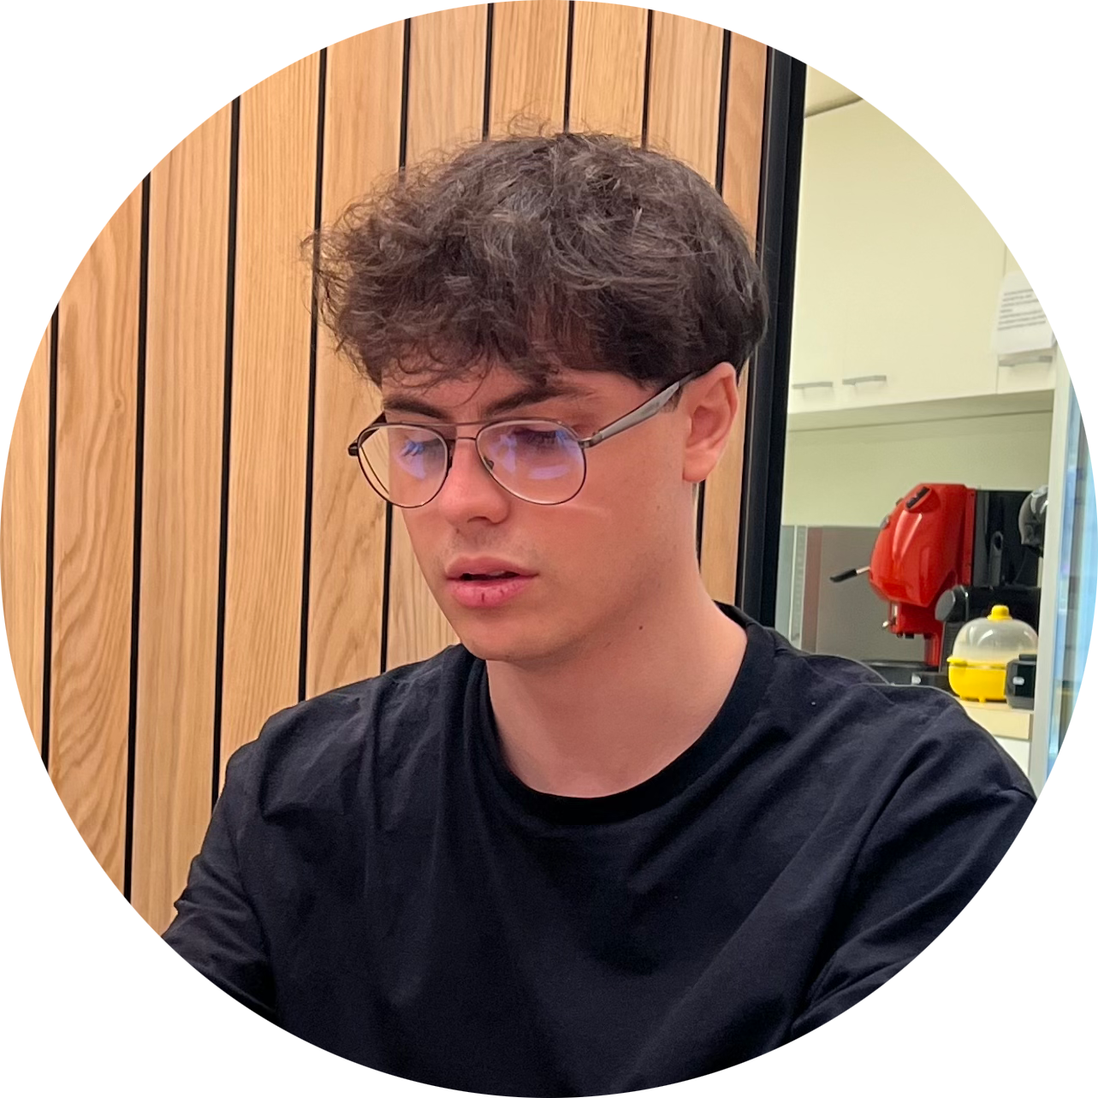


Our Team
ALESSIO PRATO
ALESSANDRO MARCELLINI
ALESSIO GANZAROLLI
B.Sc. student in Computer Science
UNIBO Motorsport Team Member
B.Eng. student in Computer Engineering
UNIBO Motorsport Team Member
Full-Stack Web Developer
B.Sc. student in Computer Science
NICOLA RICCI MACCARINI
LEONARDO PINNA
B.Sc. student in Computer Science
AI/ML Enthusiast
YouTube Content Creator
B.Sc. student in Computer Science

Slide 17
THANK YOU FOR YOUR ATTENTION!

Slide 18
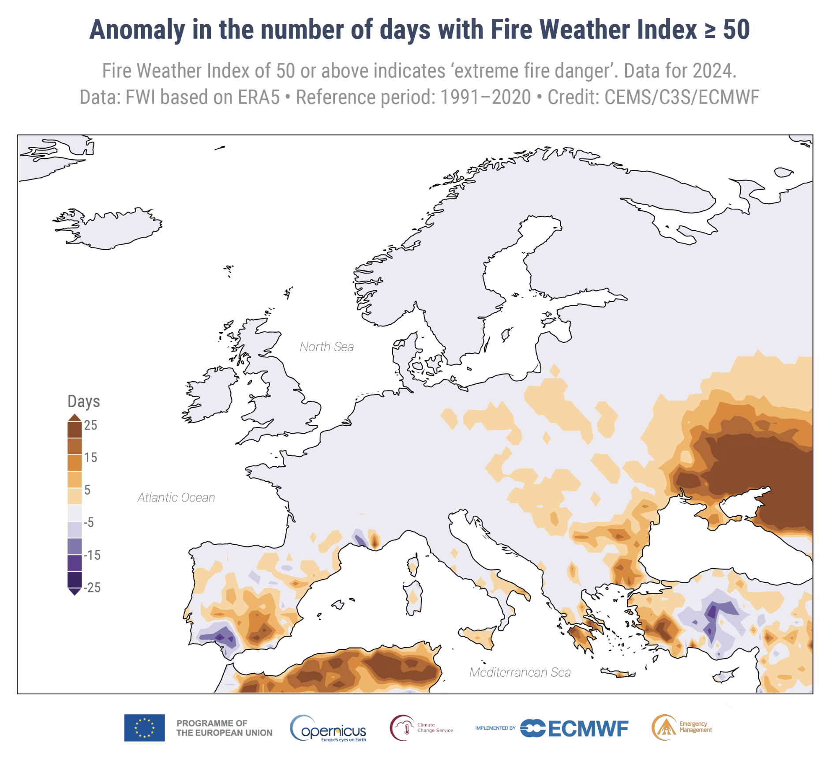
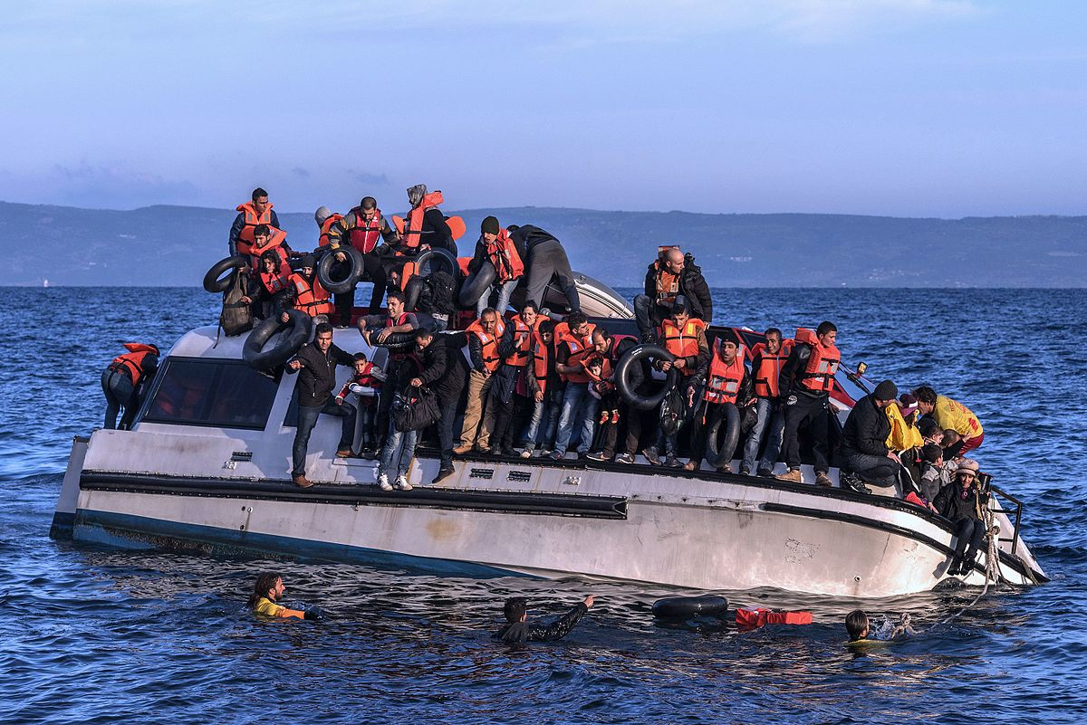
Goal: Improve humanitarian emergencies prediction

Slide 19
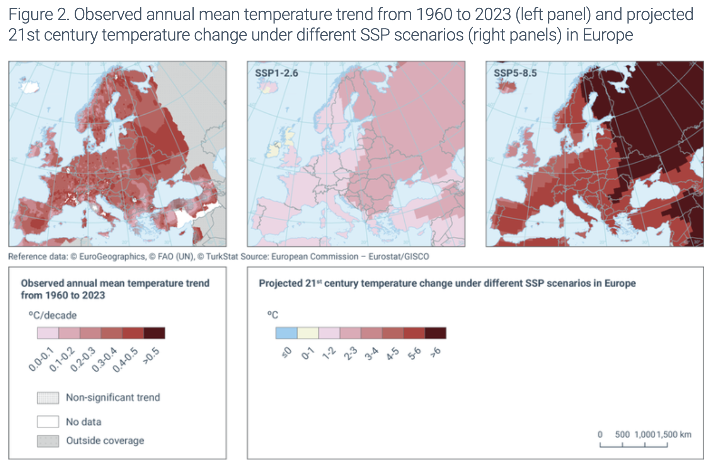
Market Analysis and Opportunity
AGING POPULATION | +2.2 YEARS 2014-2024
RISING TEMPERATURES | 1-2°C BY 2050

Slide 20
Market Analysis and Opportunity
CLIMATE EVENTS NUMBER GROWTH | ITALY 1981-2023

Slide 21
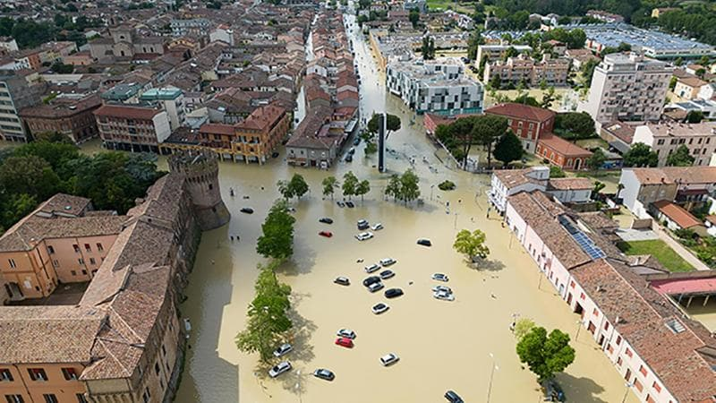
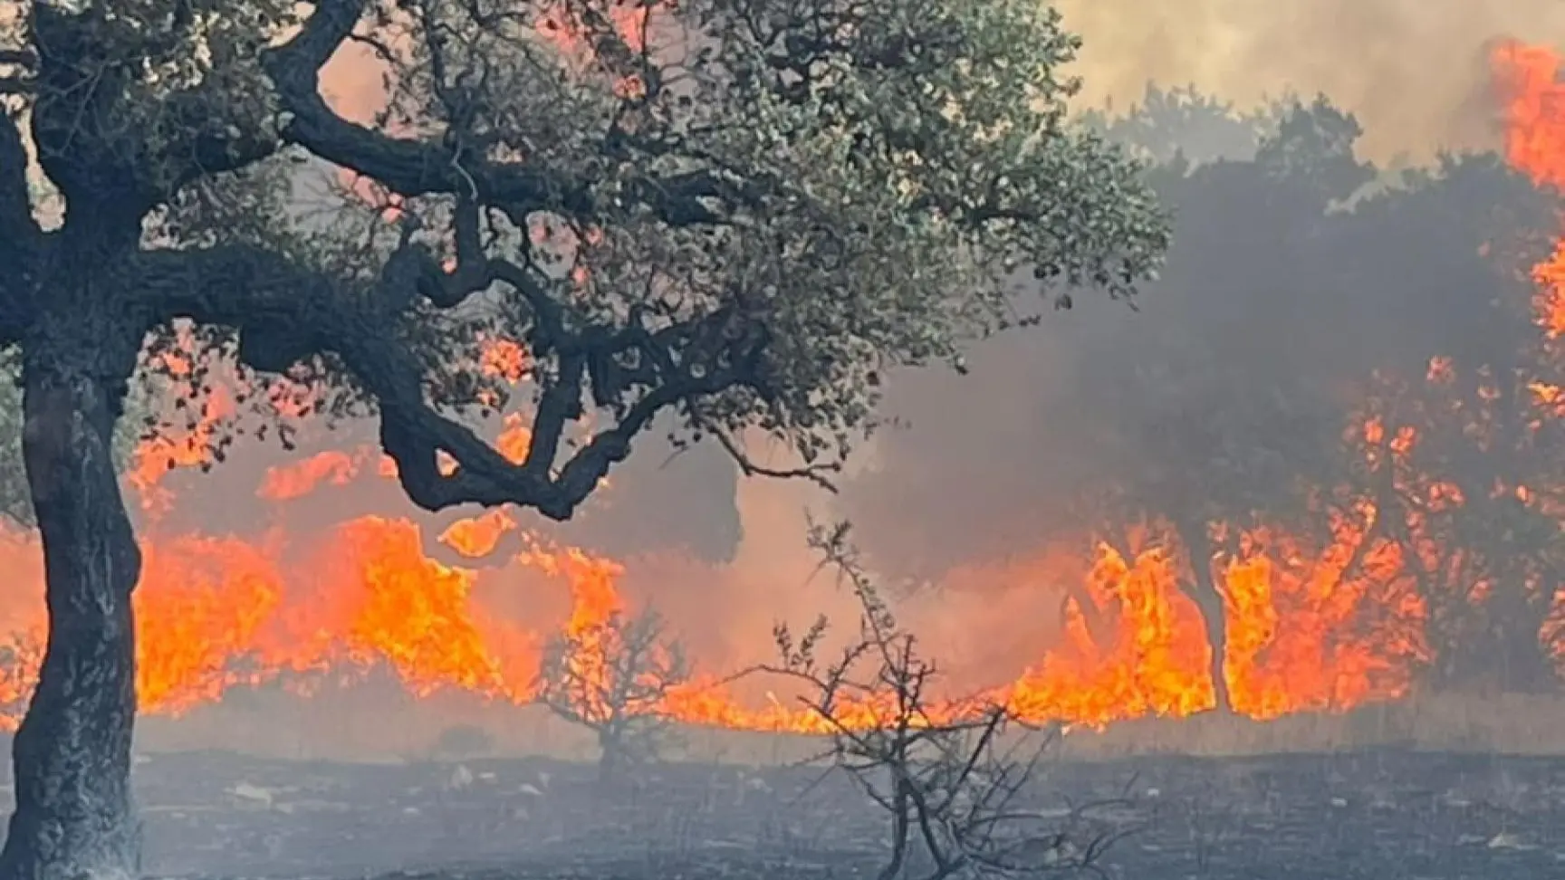
Goal: Improve Climatic Emergencies Organization
Romagna flood, May 2023 – Emilia-Romagna, Italy
Fire advancement, Summer 2024 - Sardegna, Italy

Slide 22
Italy – 2024 Data
~275.000 firefighters' interventions (2.670 per day!)

Slide 23
Problem
What do you do when you are in danger?
What do you do when you see others in danger?
Panic and paralysis?
Call 112 for help?
What if they were late?
What if there were no available connections?
What if you can’t write your message for help?
Use AIRA!

Slide 24
What is AIRA?
Geo-localization and satellite data collection
AI-enhanced data analysis
Improved time to response to rescue
SOS management system with112
ALL IN ONE APP!

Slide 25
Our Value Proposition
Easy to use – One-tap help requests
Efficient – Innovative routing algorithms using data
Reliable – Data driven decisions

Slide 26
Future Extra Features to Keep Users Engaged
Gamification (ping ogni 3 mesi, numero di vite salvate come gioco, ecc..) – Spaced repetition for better use of AIRA features
Battery evaluation to reduce drain
Drone altitude management

